Slide 1


Olympic Athlete Performance and Trends Analysis
This presentation explores the world of Olympic athlete data, analyzing trends in participation, performance, and demographics.
Parv Upadhyay

Slide 2

Introduction and Dataset Overview
Project Objective
To analyze Olympic athlete data, exploring trends in participation, performance, and demographics.
Dataset
Two primary datasets were used: Athlete Events, containing detailed athlete data, and NOC Regions, mapping National Olympic Committees to countries and regions.

Slide 3

Data Preprocessing and Handling Missing Values
Data Cleaning
Missing values in Age, Height, Weight, and Medal columns were handled. Missing medals were filled with 'No Medal'.
Median values were used for Age, Height, and Weight to maintain fairness.
Unique Values
Unique values for Sport, City, Games, etc., were displayed to ensure accurate analysis.

Slide 4
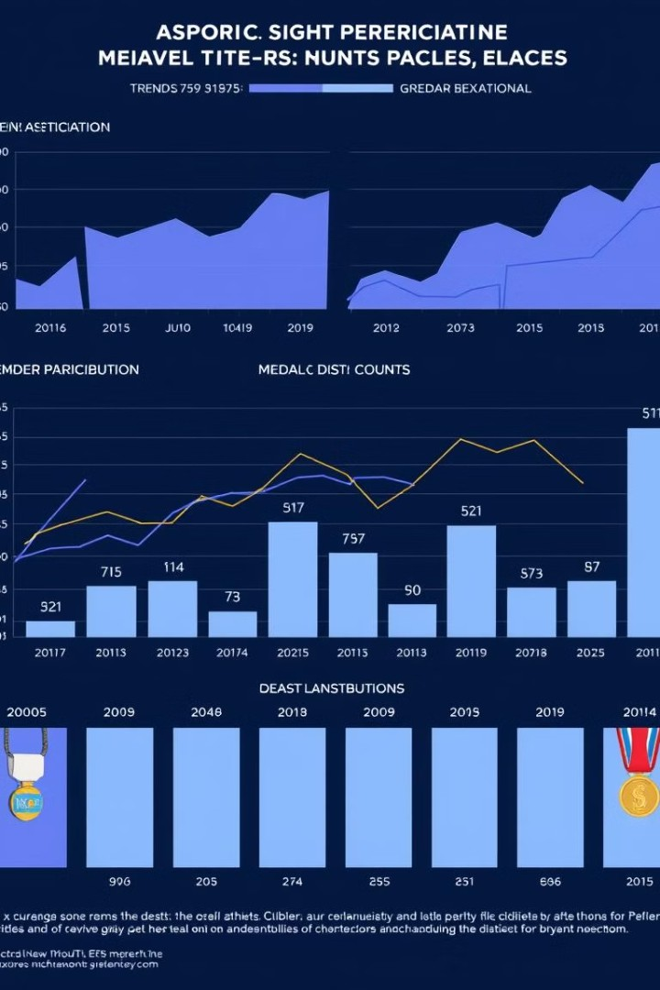



Key Visualizations and Insights
Athlete Growth
A steady increase in the number of athletes participating in the Olympics reflects global participation growth.
Gender Equality
The increasing participation of female athletes signifies progress toward gender inclusivity.
Top Countries
The USA and Russia consistently lead in total medal counts, highlighting their historical success.

Slide 5





Conclusion and Key Findings
1
Participation Growth
2
Gender Equality
3
Top Countries
Age
Athletes tend to peak in their 20s-30s.
4
Height & Weight
No strong correlation with medal outcomes.
5

Slide 6
Thank You

